Slide 1
Web Community Manager
Managing the Section Workspace
Today’s Trainer: Kit Archie

Slide 2
At the end of today’s hands-on workshop you will be able to:
Describe the structure of a WCM website.
Understand the layout of the Section Workspace.
Know where to access the Section Workspace tools & resources.
Designate a user as a Section Editor.
Understand the elements which constitute a page (Canvas, Columns, Apps).
Add pages.
Manage page Apps & Layout.
Know where and how to organize, nest, delete, and recover pages in a Section.
Notes:
http://bit.ly/basicmsw

Slide 3
Your URL
il50000633.schoolwires.net

Slide 4
Editorial Privileges
SITE DIRECTOR
Channel Director
Channel Director
Section Editor
Section Editor
Homepage Editor
Section Editor
Section Editor
SUBSITE DIRECTOR
SUBSITE DIRECTOR
Channel Director
Channel Director
Channel Director
Channel Director
Section Editor
Homepage Editor
Section Editor
Section Editor
Homepage Editor
Section Editor
Section Editor
Section Editor
Section Editor
Section Editor

Slide 5
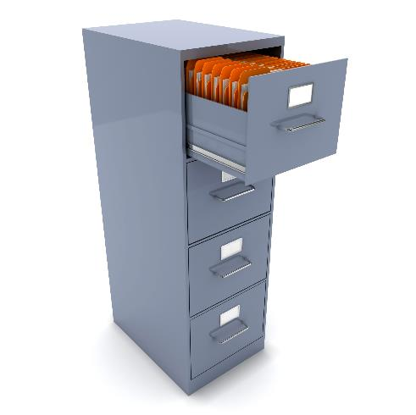

This file cabinet represents your site/sub-site.
Within each Channel
(DRAWER) is one or more folders or SECTIONS.
Within each Section
(folder) are the PAGES of information about that section.
Each CHANNEL is
like a DRAWER -
containing similar
information.

Slide 6
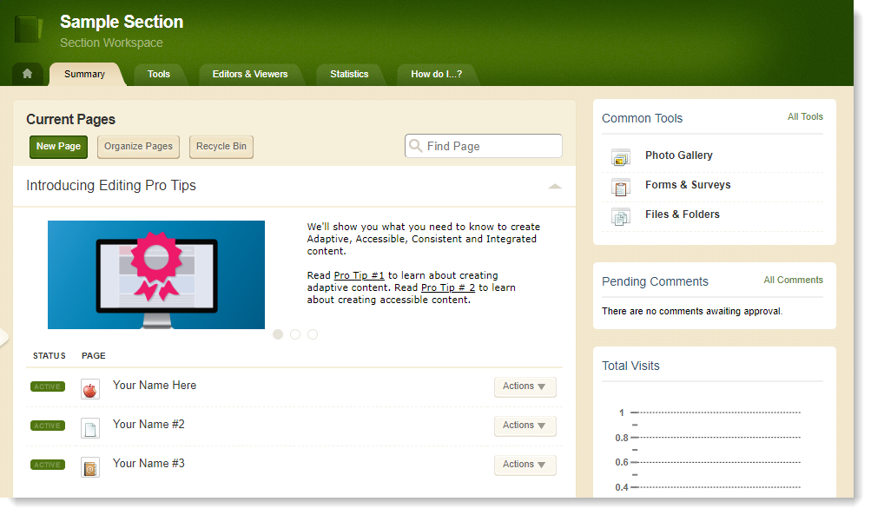
Section Workspace
Summary Tab
  Edit/organize current pages
  Create new pages
  Access the recycle bin
  Hot Topics Billboard

Slide 7
Page structure
Page Layout
The way in which the columns are arranged on a page is called the Page Layout. You can have one, two or three column layouts as well as layouts with a left or right side-bar.
Columns
You place your apps into the columns of a page layout. You can place one or more apps in a column. Many of our default pages are configured to be one column.
Apps
Apps are the content building blocks of any WCM page. You can have one or more apps on a page. You can edit your apps as well as share them with other editors. The Content App and Calendar App are just part of the app library available to you.
Column 1
Column 1
Column 2
Content App
Site Shortcuts App
Content App
Upcoming Events App

Slide 8
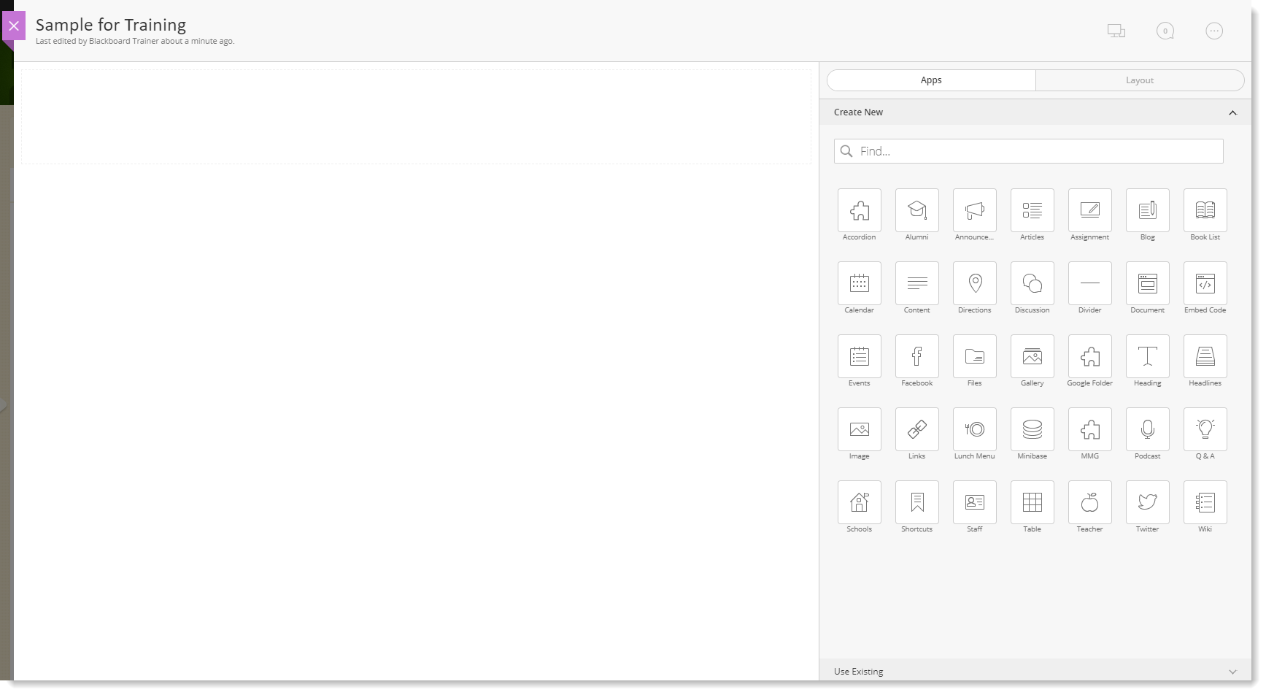
Page: Canvas and Apps

Slide 9
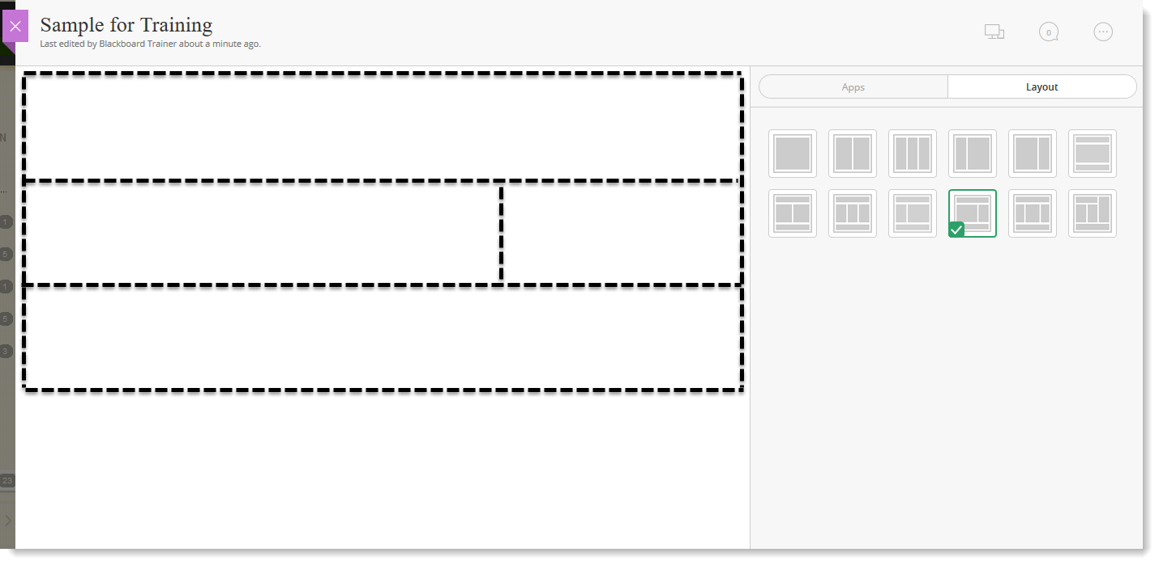
Page: Canvas and Layout

Slide 10
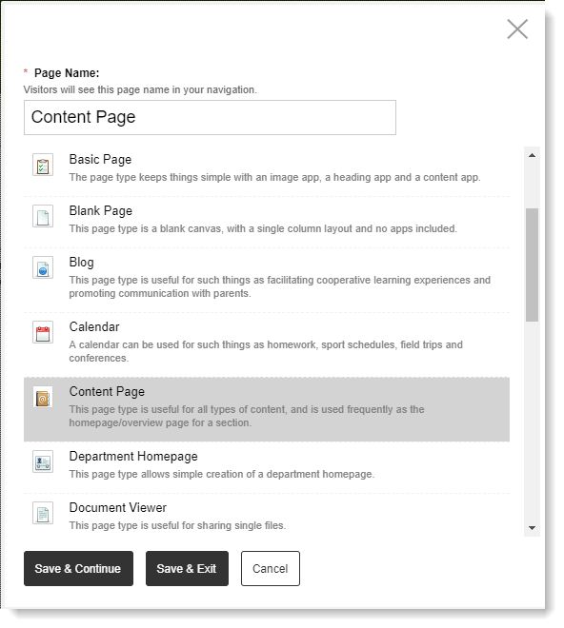
Activity: Add a Content Page Type

Slide 11
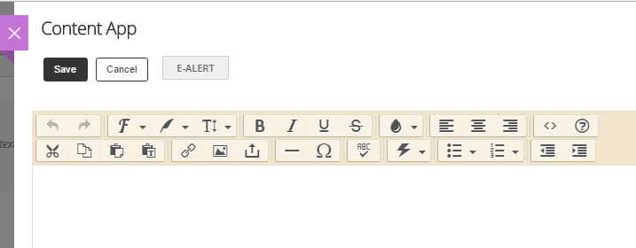
Activity: Add text, image, and links
  In your Content App
  Add Text (type or paste)
  Add an Image
  Add a Link or File
  Save

Slide 12
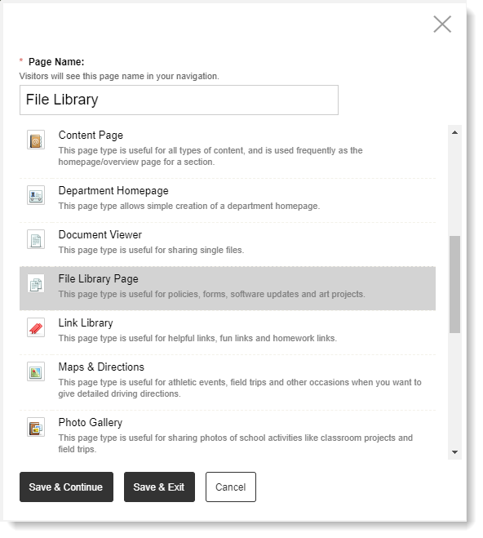
Activity: Add a File Library Page

Slide 13
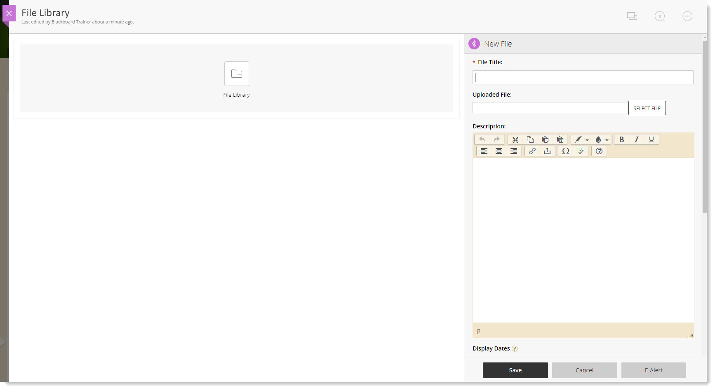
Activity: Add a File

Slide 14
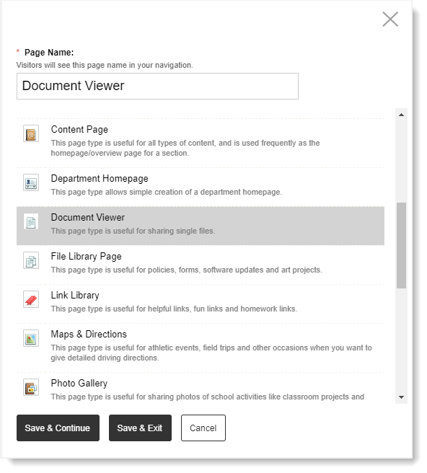
Activity: Add a Document Viewer Page

Slide 15
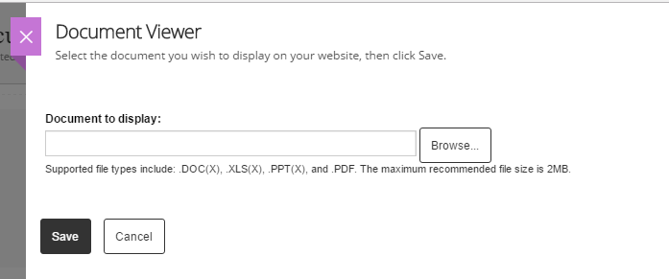
Activity: Add a Document to Display

Slide 16
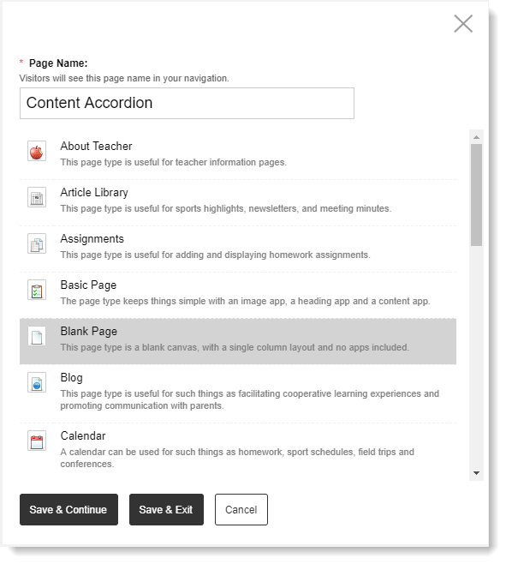
Activity: Add a Blank Page

Slide 17
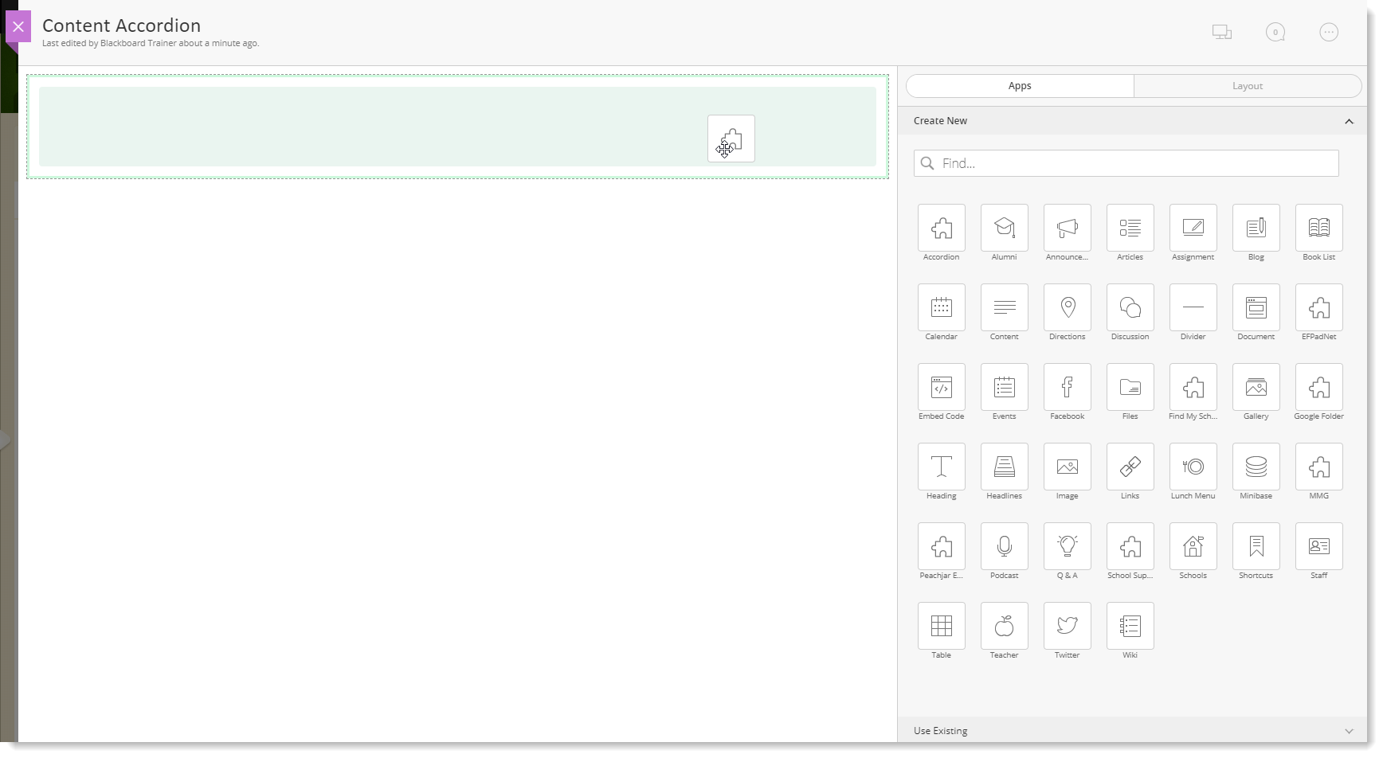
Activity: Add Accordion App
Drag & drop

Slide 18
Commonly Used Apps
Announcements App - Short and timely reminders with expiration dates
Calendar App - Events, schedules, appointments
Content App - Text, images, links, files
Document Viewer App - View a single document on a page
File Library App - Multiple documents for download
Multimedia Gallery App - Slide show for multiple images
Site Shortcuts App - Links to popular pages or external sites
Upcoming Events App - Links to your WCM calendar and shows next few events
Notes:
http://mmertz.schoolwires.net/Page/2628

Slide 19
Activity: Modify the Page Layout

Slide 20
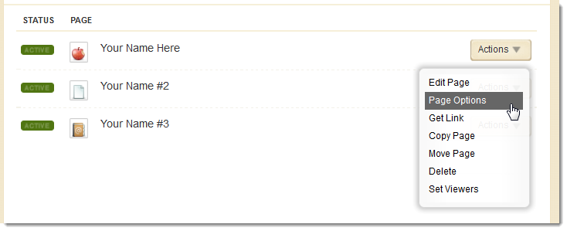
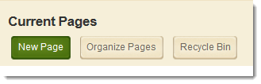
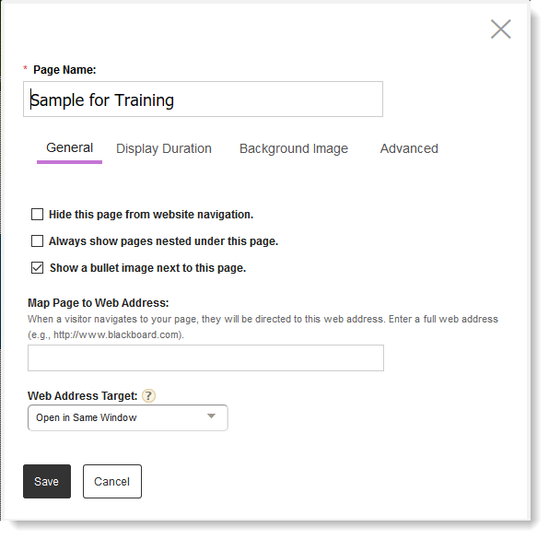
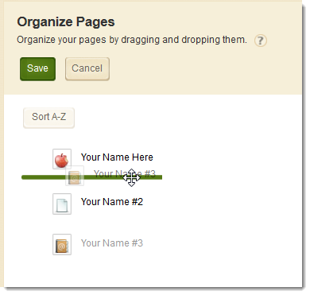
Activity: Page Options & Organizing Pages
1
2

Slide 21
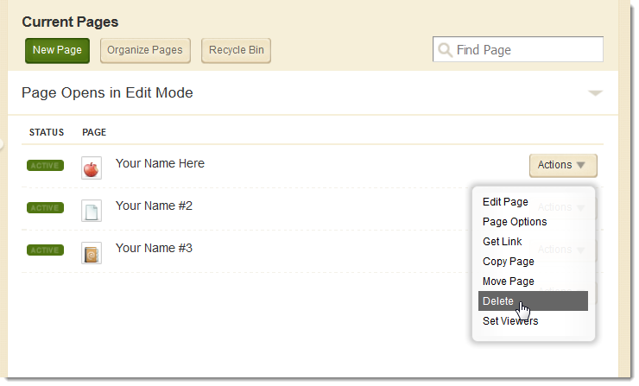
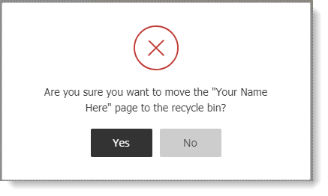
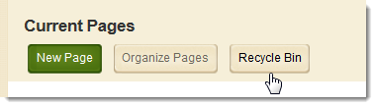
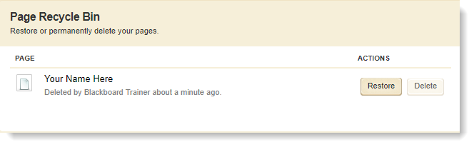
Activity: Delete and Restore Page
1
2

Slide 22
In today’s workshop our focus was to help you:
Understand the layout of the Section Workspace
Access Section Workspace Tools & Resources
Designate a user as a Section Editor
Understand the elements of a Page
Add Pages to a Section
Manage Page Apps and Layout
Organize, delete, and recover Pages in a Section.

Slide 23
We hope you’ve enjoyed today’s Workshop.
Let us know how we’re doing!
https://cerc.blackboard.com/trainingfeedback

